Slide 1



Trusted sla-guided data integration on multi-cloud environments
Daniel Aguiar da Silva Carvalho, Magellan, IAE, Université Jean Moulin Lyon3
Chirine Ghedira Guegan, Magellan, IAE, Université Jean Moulin Lyon3
Genoveva Vargas-Solar, CNRS, LIG-LAFMIA, Saint Martin d'Hères - France
Nadia Benani, CNRS INSA-Lyon, LIRIS, UMR5205 - France

Slide 2
Data integration: existing work
Query
Result
Data integration: the teenage years. Halevy, A., Rajaraman, A., & Ordille, J. (VLDB 2006, September)
Schema integration: Past, present, and future (Ram, S., & Ramesh, V. 1999)
Global schema
Mediator
Query rewriting
Data integration architectures:
Multi-databases, federations, DW, …
(Domenig & Dittrich 1999 Sigmod Record)
MiniCon algorithm for query rewriting (Pottinger and Halevy, 2001)
Exported schemata
Data
source A
Data
source B
Data
source C
Heterogeneous data sources known in advance

Slide 3
Data integration: existing work
Services lookup and matching
[1] Paolucci, M., Kawamura, T., Payne, T. R., & Sycara, K. (2002, June). Semantic matching of web services capabilities. In International Semantic Web Conference (pp. 333-347). Springer Berlin Heidelberg.
[2} Bramantoro, A., Krishnaswamy, S., & Indrawan, M. (2005, November). A semantic distance measure for matching web services. In International Conference on Web Information Systems Engineering (pp. 217-226). Springer Berlin Heidelberg.
[3} APA Maximilien, E. M., & Singh, M. P. (2004, November). Toward autonomic web services trust and selection. In Proceedings of the 2nd international conference on Service oriented computing (pp. 212-221). ACM.
Query
Result
Mediator
Query rewriting techniques adapted to service composition
Exported API
[4] Barhamgi, M., Benslimane, D., and Medjahed, B. (2010). A query rewriting approach for web service composition. IEEE T. Services Computing, 3(3):206–222.
[5] da Costa, U. S., Alves, M. H. F., Musicante, M. A., and Robert, S. (2013). Automatic refinement of service compositions. In Daniel, F., Dolog, P., and Li, Q., editors, ICWE, volume 7977 of Lecture Notes in Com- puter Science, pages 400–407. Springer.
[6] Zhao, W., Liu, C., and Chen, J. (2011). Automatic composition of information-providing web services based on query rewriting. Science China Information Sciences, pages 1–17.
. . .
Distributed data services

Slide 4
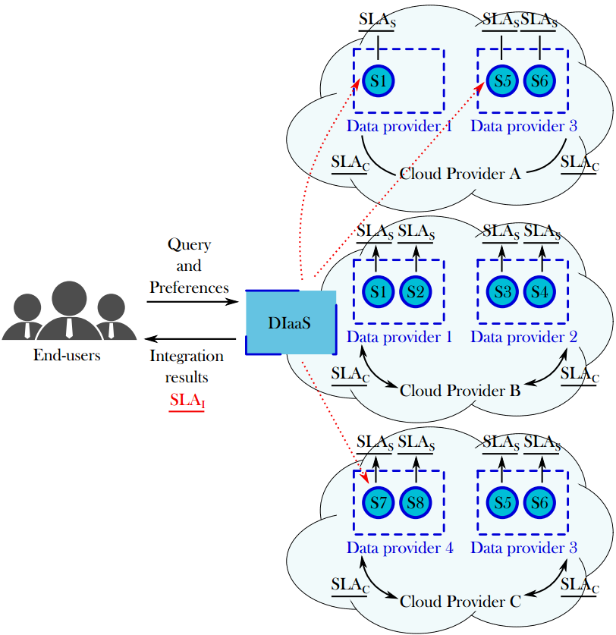
Context
Challenges:
Which services should I select ? Are the requirements being respected?
How to be sure that all SLAs are being respected?
How to integrate different SLAs associated to services involved with user’s requirements?
How results can be reused for a next query?
Objective:
To propose a data integration solution in a multi-cloud environment guided by user requirements and SLA exported by different clouds.

Slide 5
contributions
Problem statement and state of art: Systematic mapping (DEXA 2015)
Design, formalization and implementation of a query rewriting algorithm for data integration taking into account user preferences and services’ quality aspects defined on SLA contracts (ADBIS 2016 / ICSOC 2016)
Design of the metamodel for data integration in a multi-cloud context (ICSOC 2016)
Design of the different types of SLA: Cloud SLA, Service SLA and Integration SLA
Formalization of the incoming query variations and the integration reusability solution

